Slide 2
Installation Party! 🎉🎉🎉

Slide 3
Installation Party - Pre-flight checklist
Working laptop
Student registration
ETH email ID
Moodle
ETH Google Account
Slack

Slide 4
Installation Party - Pre-flight checklist
Working laptop ✅
Student registration
ETH email ID
Moodle
ETH Google Account
Slack

Slide 5

Installation Party - Pre-flight checklist

Slide 6
Installation Party - Pre-flight checklist
Working laptop ✅
Student registration ✅
ETH email ID
Moodle
ETH Google Account
Slack

Slide 7
Installation Party - Pre-flight checklist
Working laptop ✅
Student registration ✅
ETH email ID ✅
Moodle
ETH Google Account
Slack

Slide 8
Installation Party - Pre-flight checklist
Working laptop ✅
Student registration ✅
ETH email ID ✅
Moodle ✅
ETH Google Account
Slack

Slide 9
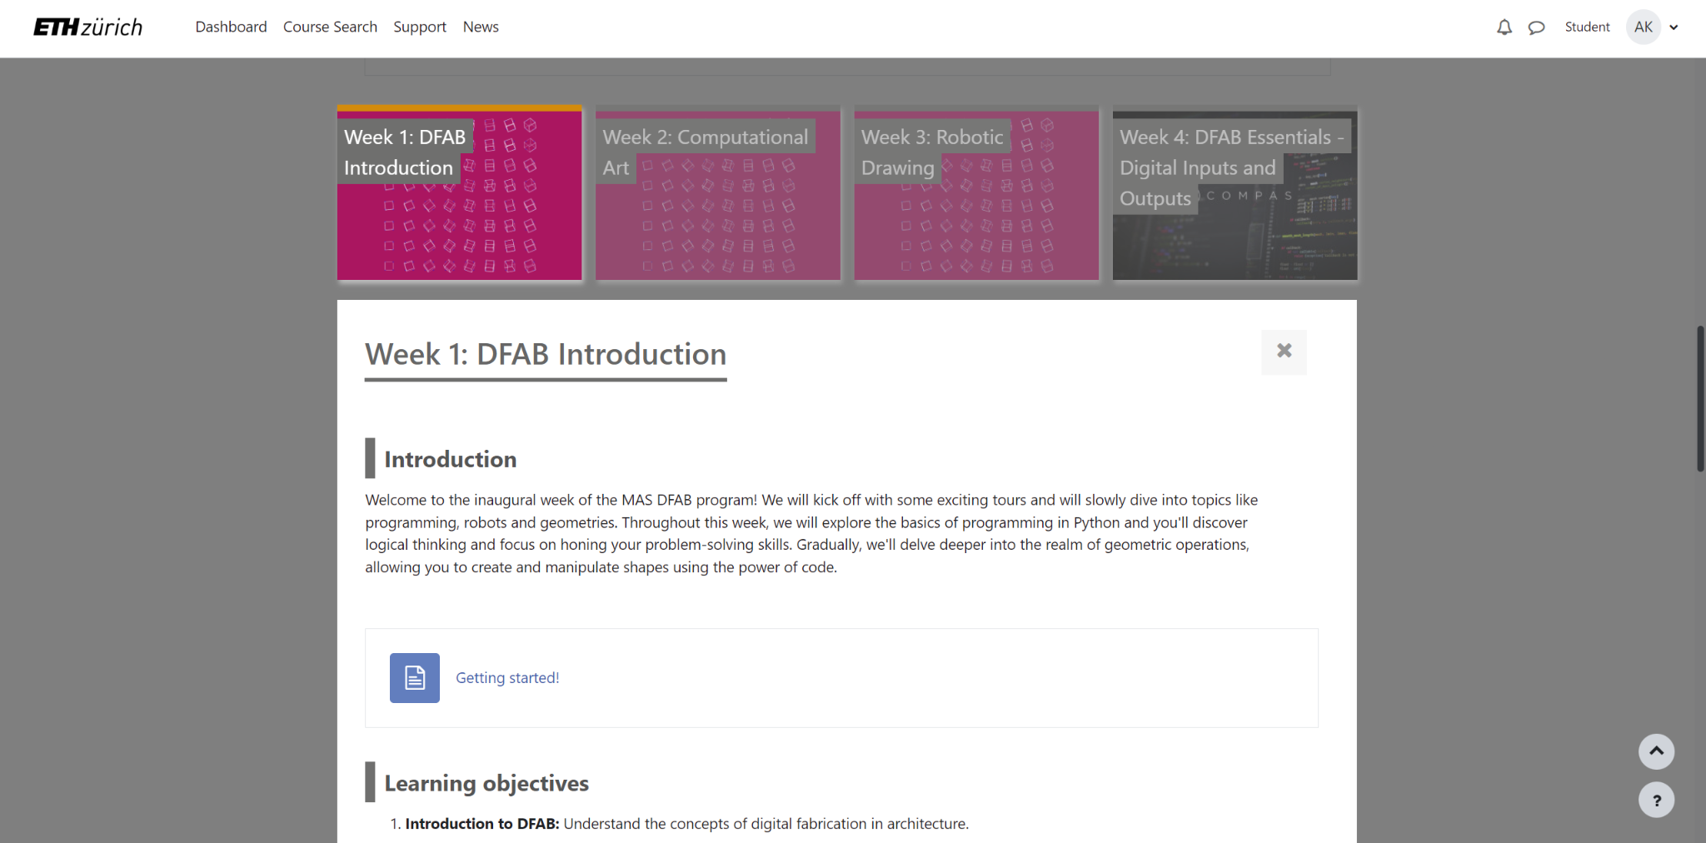
Installation Party - Tools

Slide 10
Installation Party - Pre-flight checklist
Working laptop ✅
Student registration ✅
ETH email ID ✅
Moodle ✅
ETH Google Account ✅
Slack

Slide 11
Installation Party - Pre-flight checklist
Working laptop ✅
Student registration ✅
ETH email ID ✅
Moodle ✅
ETH Google Account ✅
Slack ✅

Slide 12

Installation Party - Pre-flight checklist
say hello on

Slide 13




Installation Party - Tools

Slide 14
Installation Party - Tools

Slide 15
Installation Party - Tools

Slide 16
Installation Party - Tools

